Slide 1
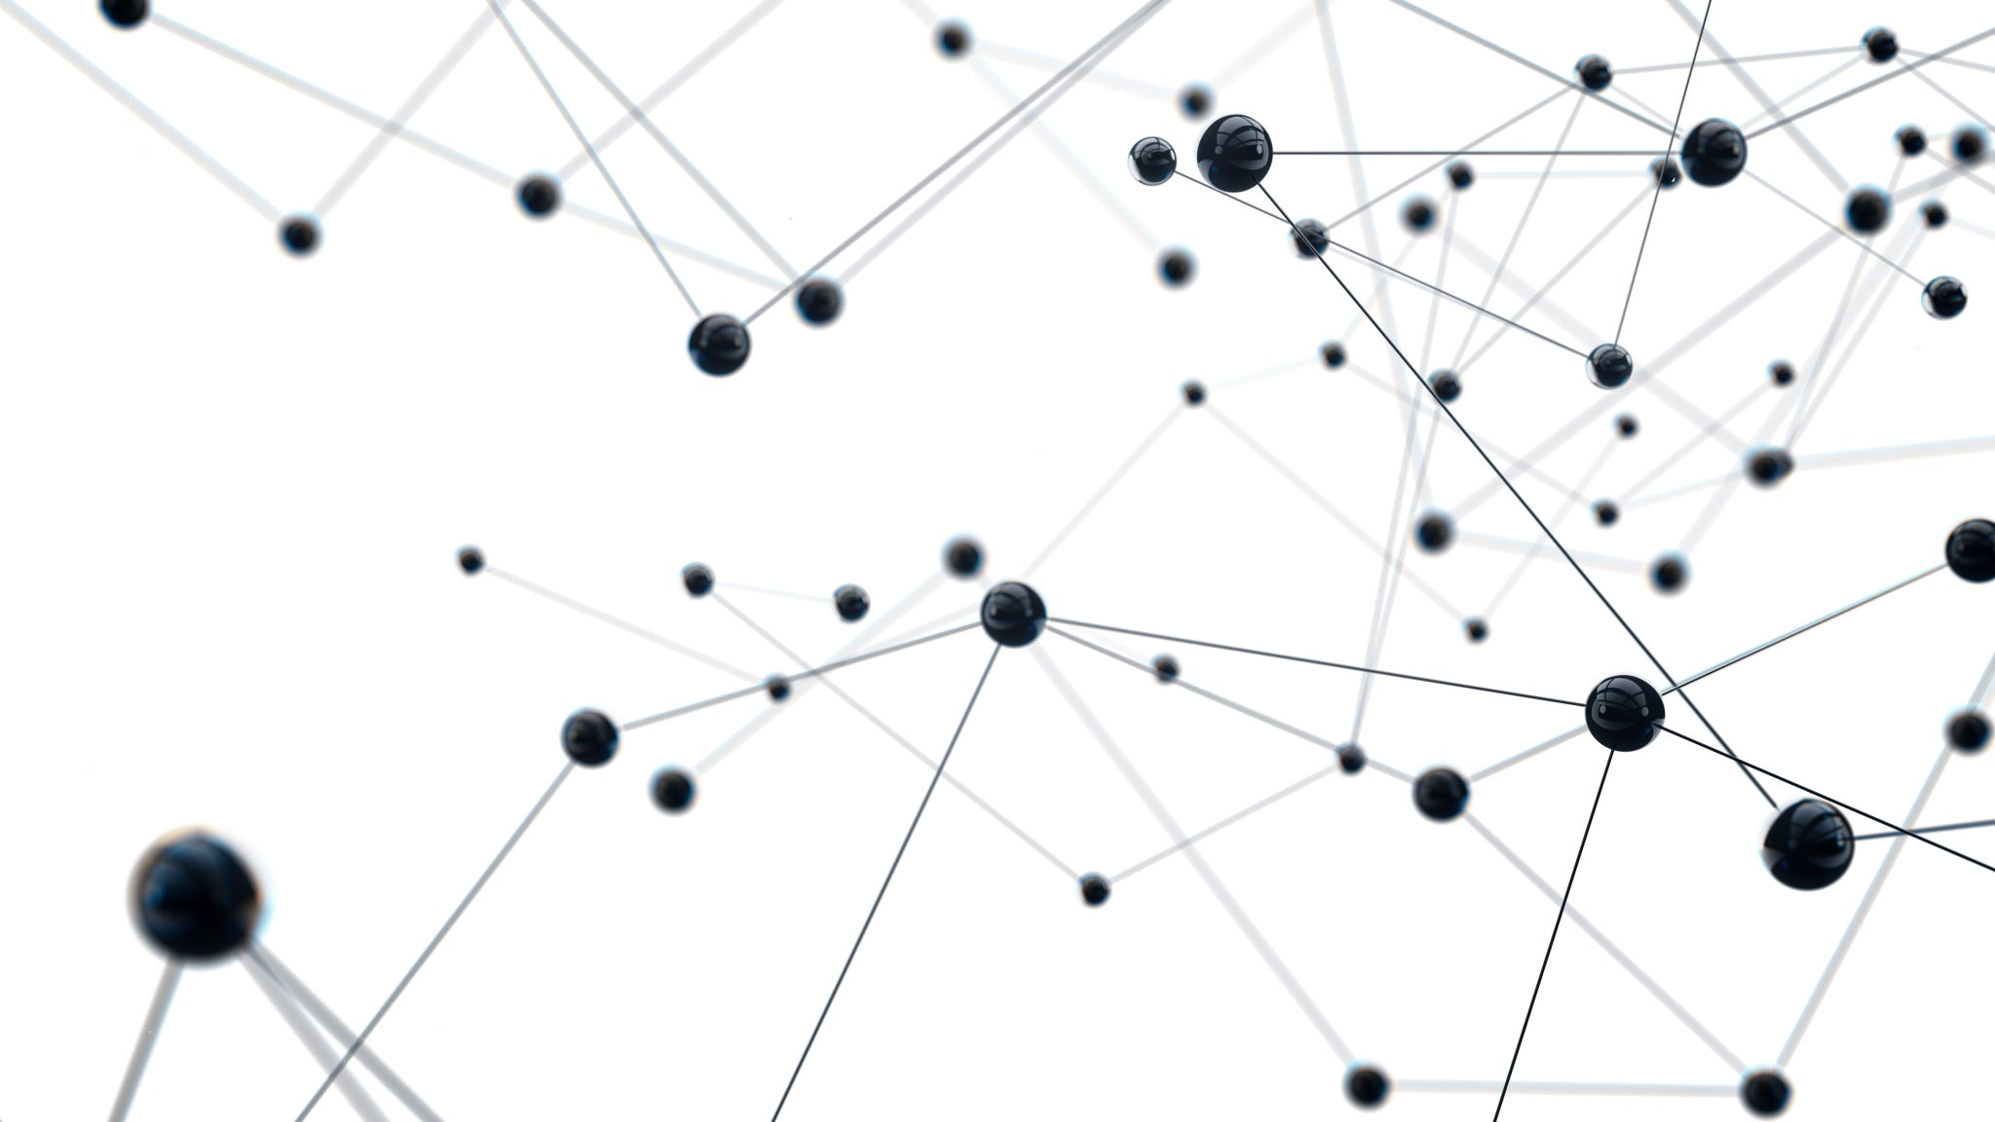
Development of machine learning models to process Electronic Health Records – Imputation Strategies
Week 23 Meeting, 28/3/2021

Slide 2
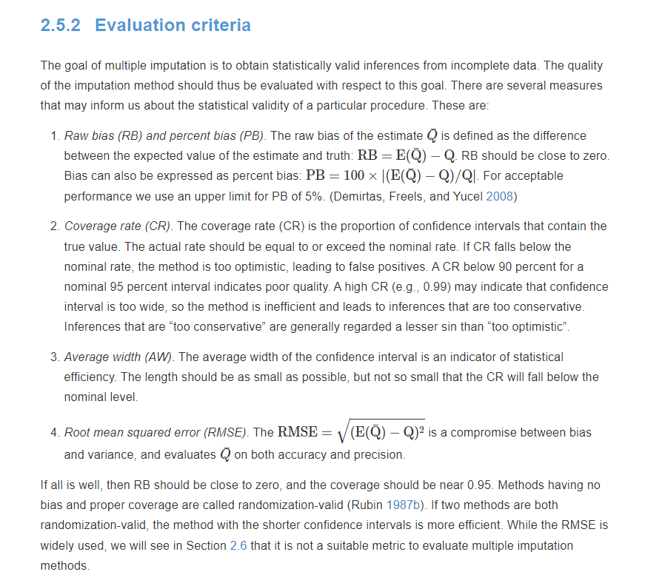
Evaluation metrics cannot be used
We don’t have the true labels
We cannot do masked data since there is
basically a missing value in every row

Slide 3
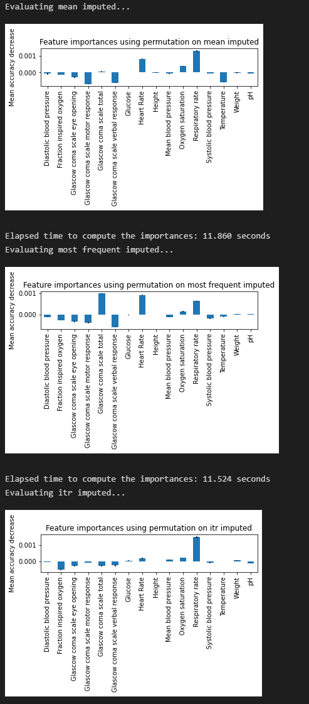
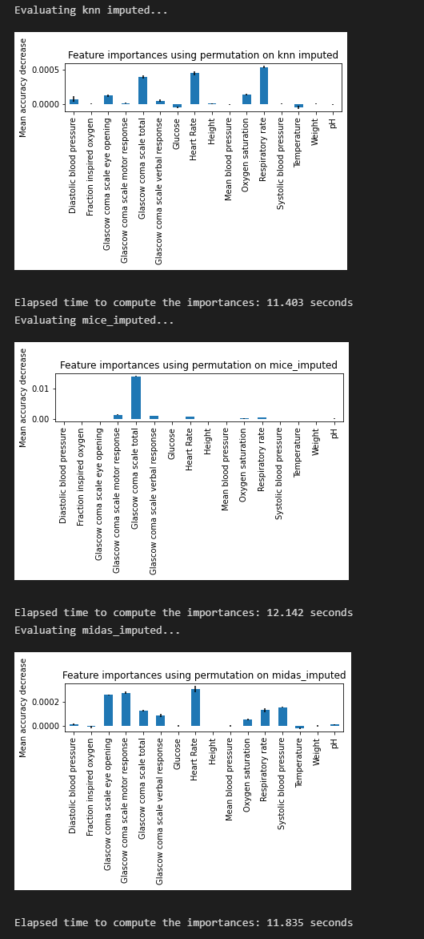
Feature importance
Random Forest
[mean imputed]
f1_macro: 0.783 (+/- 0.020)
Accuracy: 0.779 (+/- 0.027)
Precision: 0.787 (+/- 0.027)
Recall: 0.778 (+/- 0.021)
[most frequent imputed]
f1_macro: 0.782 (+/- 0.023)
Accuracy: 0.785 (+/- 0.020)
Precision: 0.790 (+/- 0.019)
Recall: 0.785 (+/- 0.031)
[itr imputed]
f1_macro: 0.781 (+/- 0.024)
Accuracy: 0.784 (+/- 0.025)
Precision: 0.788 (+/- 0.022)
Recall: 0.772 (+/- 0.033)
[knn imputed]
f1_macro: 0.772 (+/- 0.032)
Accuracy: 0.771 (+/- 0.027)
Precision: 0.783 (+/- 0.031)
Recall: 0.754 (+/- 0.038)
[mice_imputed]
f1_macro: 0.777 (+/- 0.020)
Accuracy: 0.777 (+/- 0.019)
Precision: 0.803 (+/- 0.024)
Recall: 0.736 (+/- 0.042)
[midas_imputed]
f1_macro: 0.755 (+/- 0.013)
Accuracy: 0.756 (+/- 0.017)
Precision: 0.779 (+/- 0.021)
Recall: 0.736 (+/- 0.021)
Logistic Regresison
[mean imputed]
f1_macro: 0.716 (+/- 0.038)
Accuracy: 0.717 (+/- 0.038)
Precision: 0.738 (+/- 0.042)
Recall: 0.673 (+/- 0.040)
[most frequent imputed]
f1_macro: 0.702 (+/- 0.021)
Accuracy: 0.705 (+/- 0.021)
Precision: 0.756 (+/- 0.031)
Recall: 0.608 (+/- 0.027)
[itr imputed]
f1_macro: 0.706 (+/- 0.012)
Accuracy: 0.707 (+/- 0.011)
Precision: 0.739 (+/- 0.015)
Recall: 0.643 (+/- 0.030)
[knn imputed]
f1_macro: 0.686 (+/- 0.023)
Accuracy: 0.687 (+/- 0.022)
Precision: 0.704 (+/- 0.022)
Recall: 0.645 (+/- 0.053)
[mice_imputed]
f1_macro: 0.721 (+/- 0.023)
Accuracy: 0.721 (+/- 0.023)
Precision: 0.740 (+/- 0.027)
Recall: 0.682 (+/- 0.029)
[midas_imputed]
f1_macro: 0.695 (+/- 0.030)
Accuracy: 0.696 (+/- 0.030)
Precision: 0.719 (+/- 0.035)
Recall: 0.644 (+/- 0.042)

Slide 4
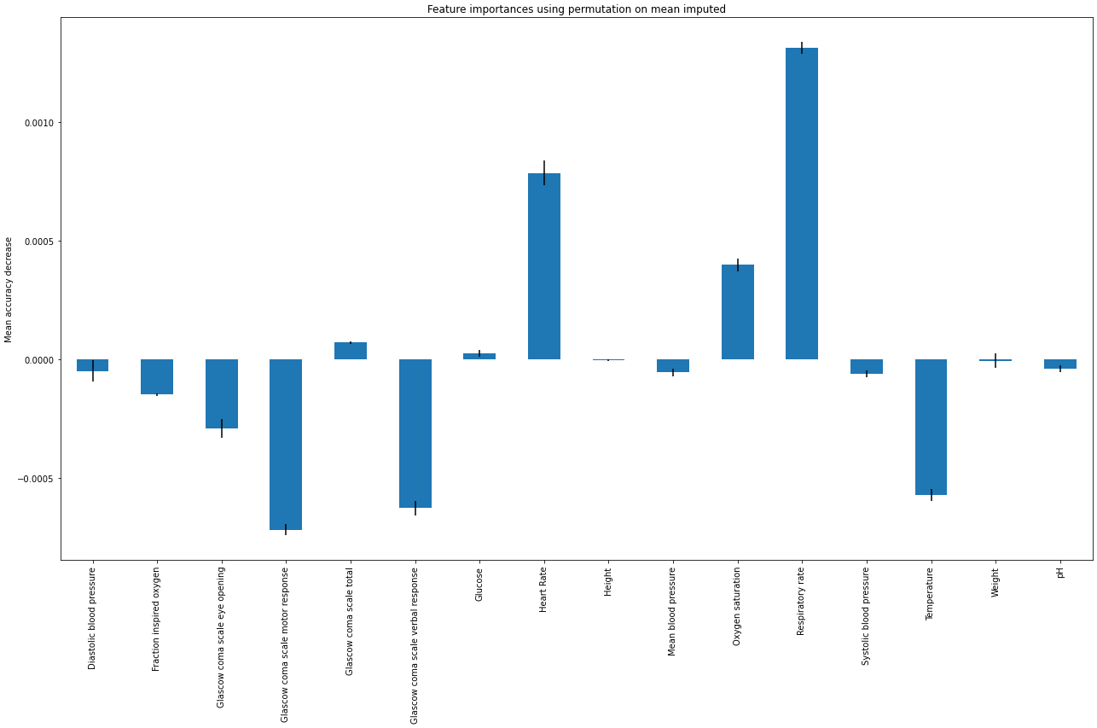
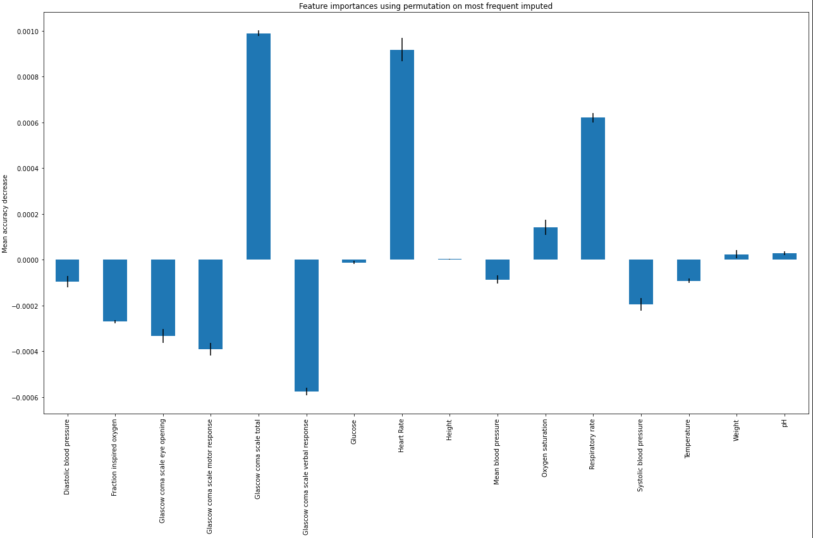
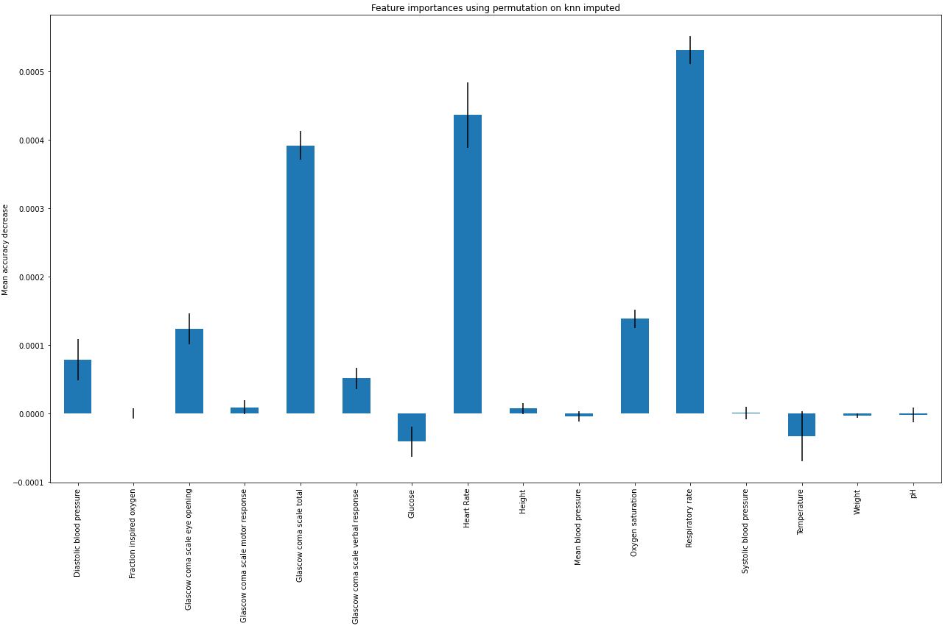
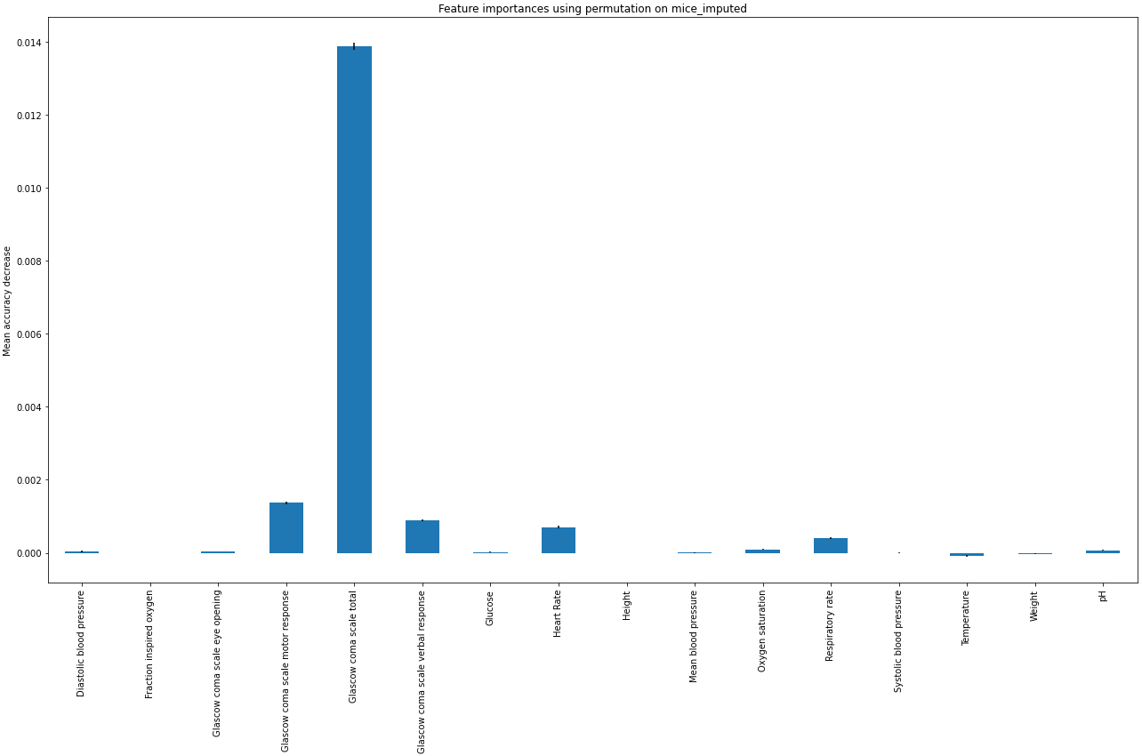
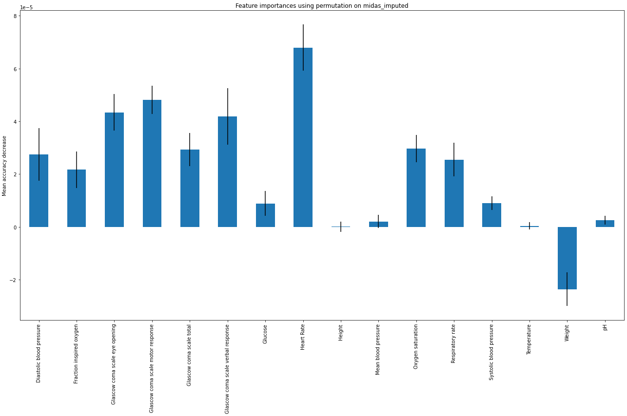
Correlation coefficient

Slide 5
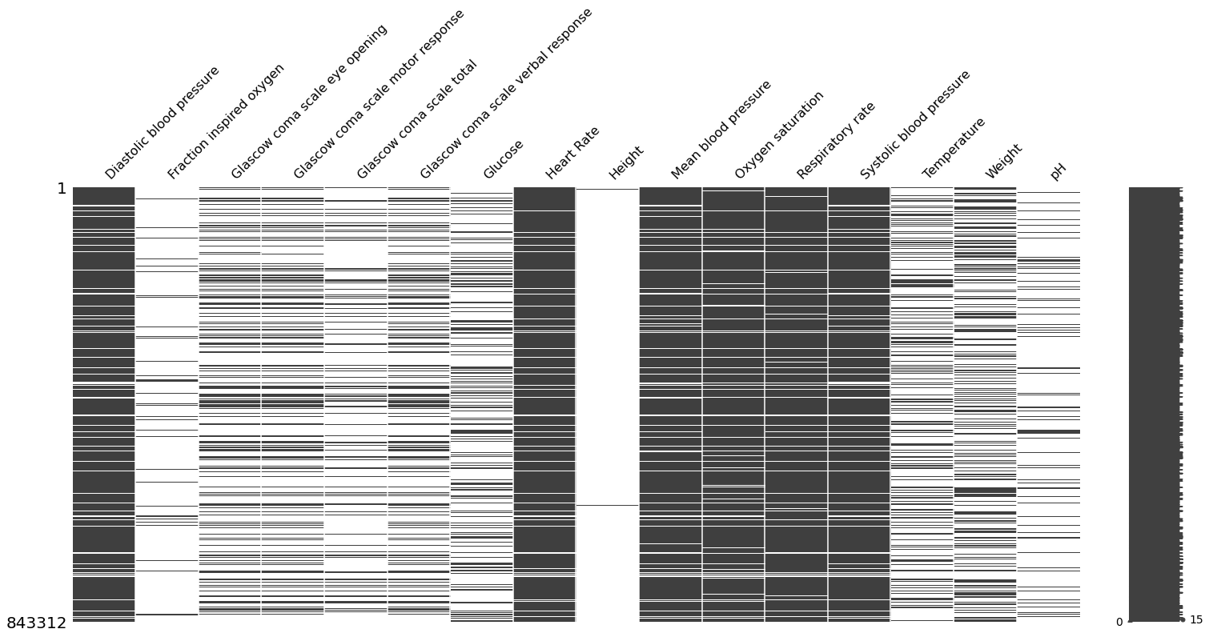
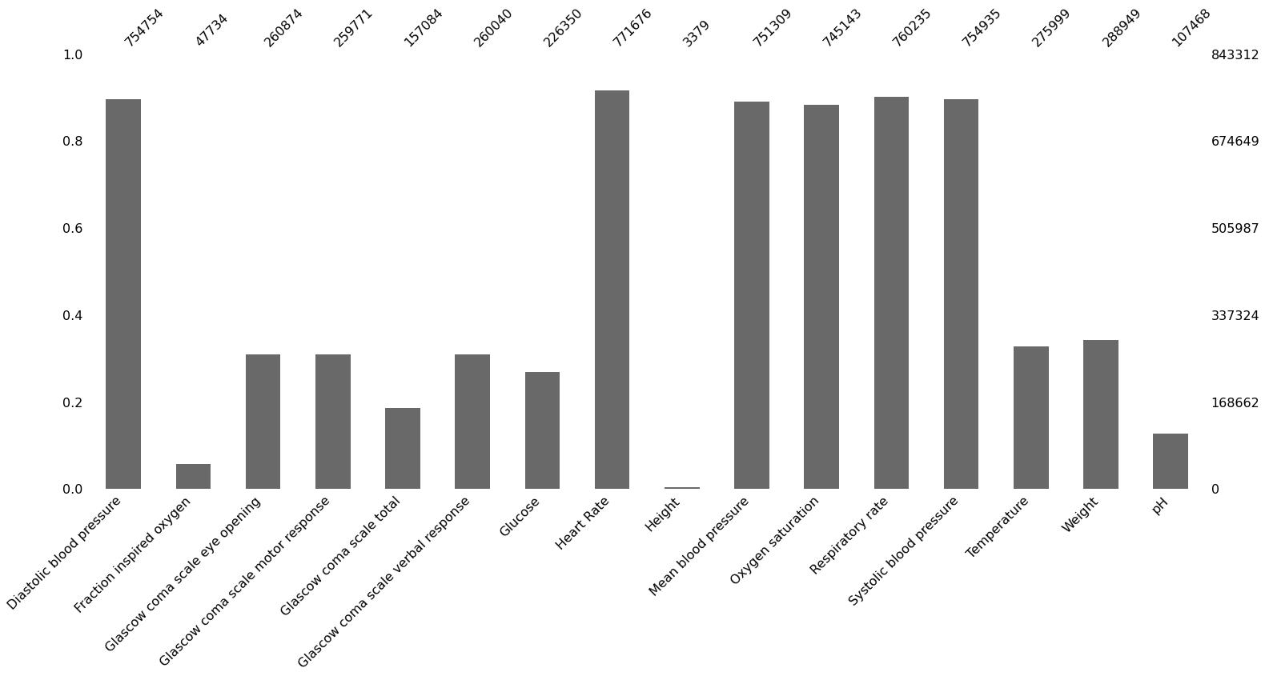
Where should I put missingness?
Implementation?
Results?

Slide 6
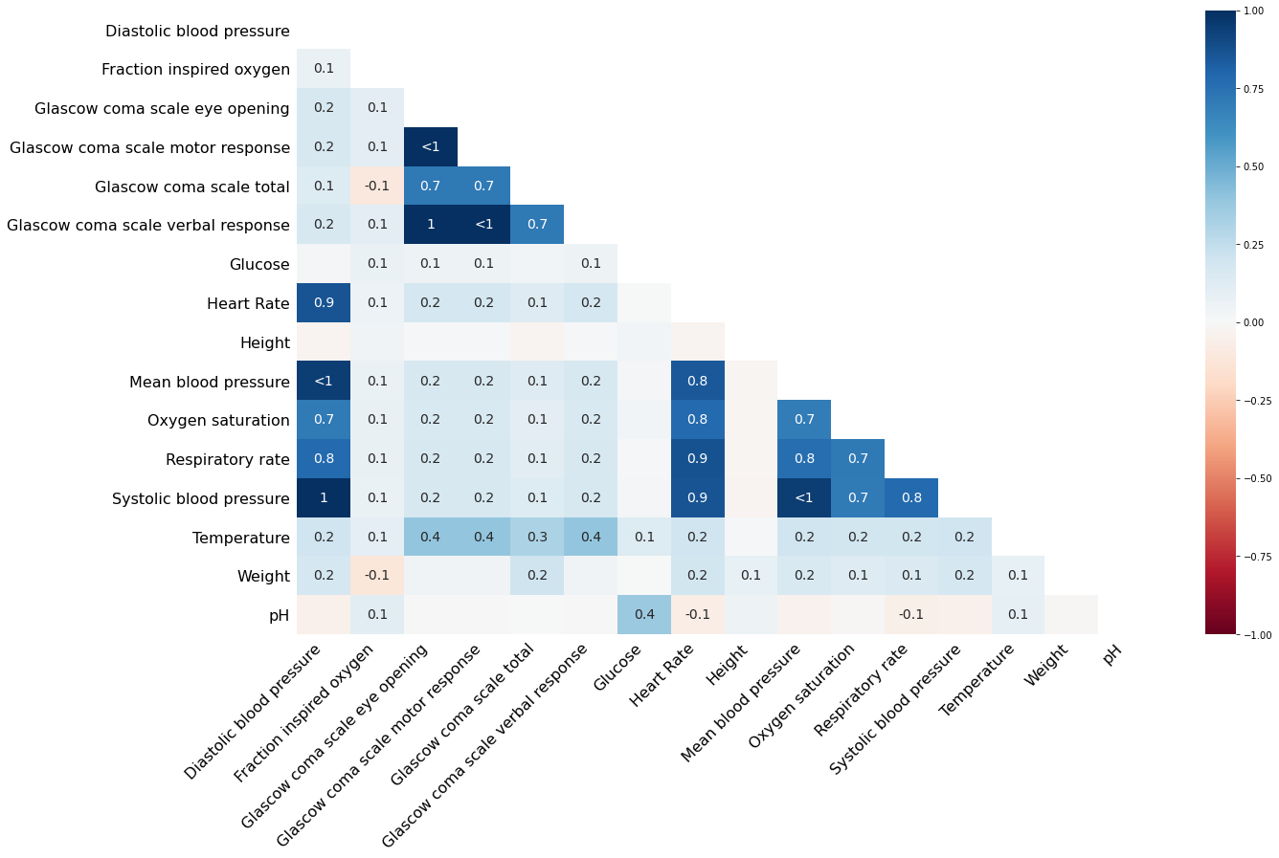

Slide 7
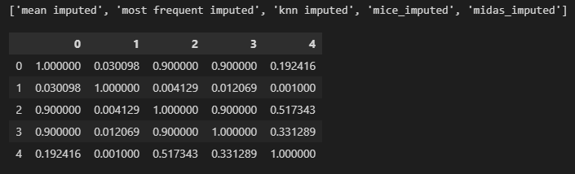
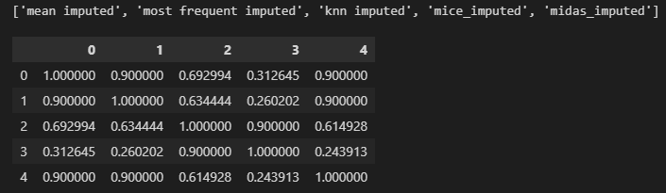
Hypothesis testing results
Logistic Regression
Random Forest
Friedman Test
Nemenyi Test

Slide 8
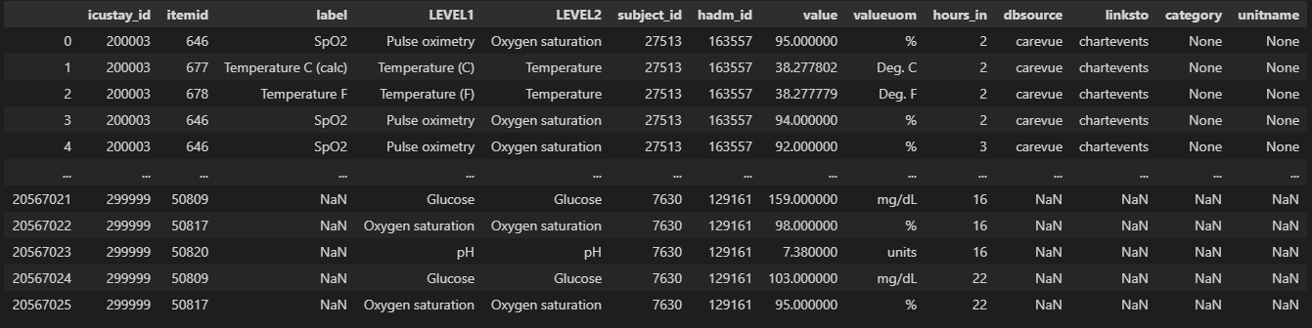
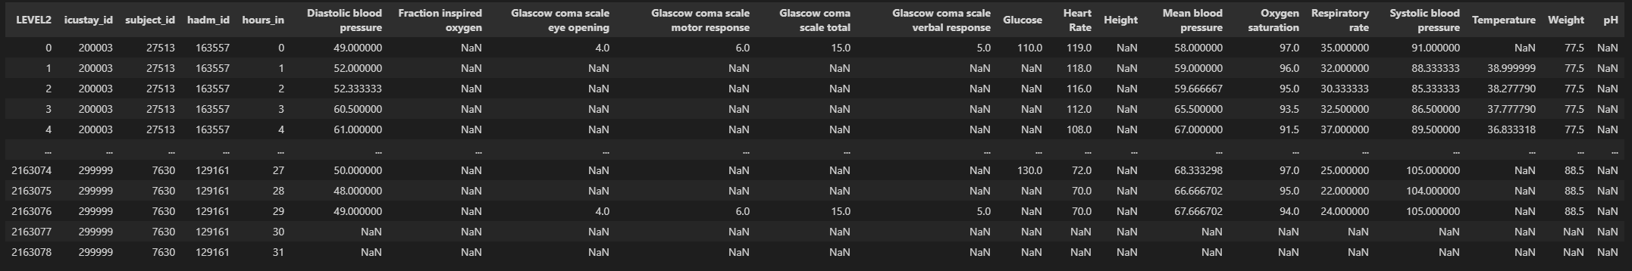

Slide 9
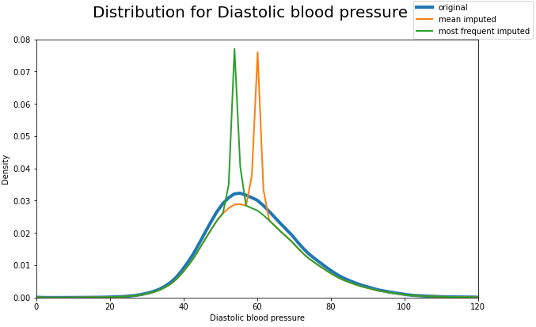
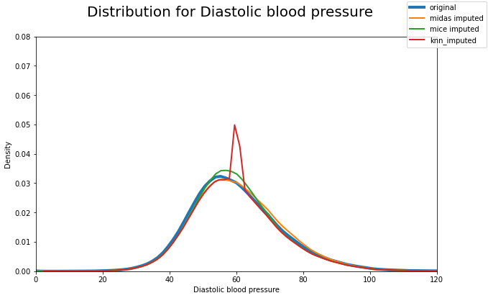

Slide 10
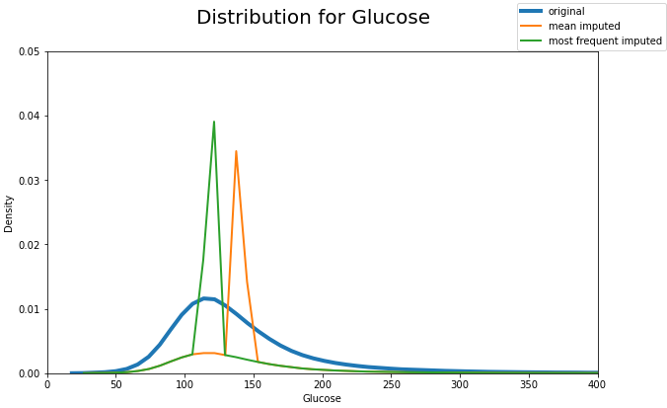
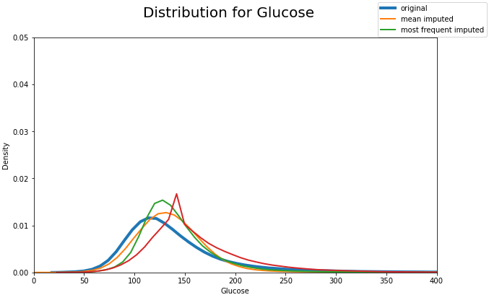

Slide 11
Univariate VS multiVariate
Features
Var 1
Var 2
Var 3
Var 4
Var 5
Patient 1
1st Hour
2nd Hour
3rd Hour
Patient 2
1st Hour
2nd Hour
3rd Hour
Features
Var 1
Var 2
Var 3
Var 4
Var 5
Patient 1
1st Hour
2nd Hour
3rd Hour
Patient 2
1st Hour
2nd Hour
3rd Hour

Slide 12


Mean impuation
Features
Features
Var 1
Var 2
Var 3
Var 4
Var 5
Var 1
Var 2
Var 3
Var 4
Var 5
0.8 | 0.6 | 0.5 | 0.3
0.5 | 0.5 |  | 0.7 | 0.2
 | 0.7 | 0.7 | 0.7 | 0.4
0.6 | 0.9 | 0.4 | 0.6 | 0.6
0.4 | 0.3 | 0.6 |  | 0.7
0.7 | 0.1 | 0.5 | 0.5 | 0.3
Impute value using calculated mean and repeat for all variables across the data
0.8 | 0.6 | 0.5 | 0.3
0.5 | 0.5 |  | 0.7 | 0.2
0.6 | 0.7 | 0.7 | 0.7 | 0.4
0.6 | 0.9 | 0.4 | 0.6 | 0.6
0.4 | 0.3 | 0.6 |  | 0.7
0.7 | 0.1 | 0.5 | 0.5 | 0.3
Patient 1
1st Hour
2nd Hour
3rd Hour
Patient 2
1st Hour
2nd Hour
3rd Hour
Calculate the mean of Var 1
Calculate the mean of Var 3
$$mean= \frac{0.8 + 0.5 + 0.6 + 0.4 + 0.7}{5}=0.6$$
$$mean= \frac{0.5 + 0.7 + 0.4 + 0.6 + 0.5}{5}=0.54$$

Slide 13
Most Frequent imputation
Features
Features
Var 1
Var 2
Var 3
Var 4
Var 5
Var 1
Var 2
Var 3
Var 4
Var 5
0.8 | 0.6 | 0.5 | 0.3
0.5 | 0.5 |  | 0.7 | 0.2
 | 0.7 | 0.7 | 0.7 | 0.4
0.6 | 0.9 | 0.4 | 0.6 | 0.6
0.4 | 0.3 | 0.6 |  | 0.7
0.6 | 0.1 | 0.5 | 0.5 | 0.3
Impute value using most frequent value and repeat across all features
0.8 | 0.6 | 0.5 | 0.3
0.5 | 0.5 |  | 0.7 | 0.2
0.6 | 0.7 | 0.7 | 0.7 | 0.4
0.6 | 0.9 | 0.4 | 0.6 | 0.6
0.4 | 0.3 | 0.6 |  | 0.7
0.7 | 0.1 | 0.5 | 0.5 | 0.3
Patient 1
1st Hour
2nd Hour
3rd Hour
Patient 2
1st Hour
2nd Hour
3rd Hour
Count the occurrence of each value in Var 1
Count the occurrence of each value in Var 3
0.8 | 0.5 | 0.6 | 0.4
1 | 1 | 2 | 1
0.6 is most frequent
0.5 | 0.7 | 0.4 | 0.6
2 | 1 | 1 | 1
0.5 is most frequent

Slide 14

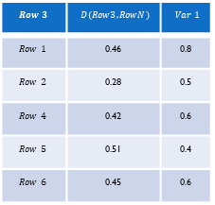
KNN impuation
Repeat for all missing values
Features
Var 1
Var 2
Var 3
Var 4
Var 5
0.8 | 0.6 | 0.5 | 0.3
0.5 | 0.5 |  | 0.7 | 0.2
 | 0.7 | 0.7 | 0.7 | 0.4
0.6 | 0.9 | 0.4 | 0.6 | 0.6
0.4 | 0.3 | 0.6 |  | 0.7
0.6 | 0.1 | 0.5 | 0.5 | 0.3
$$Row 3$$ | $$D(Row3, RowN)$$ | $$Var 1$$
$$Row 1$$ | 0.46 | 0.8
$$Row 2$$ | 0.28 | 0.5
$$Row 4$$ | 0.42 | 0.6
$$Row 5$$ | 0.51 | 0.4
$$Row 6$$ | 0.45 | 0.6
Row 1
Row 2
Calculate Euclidean Distance with all rows to create distance matrix
Row 3
Row 4
Row 5
Row 6
$$d\left(Row 3,Row 2\right)= \sqrt{{\left(0.7−0.5\right)}^{2}+{\left(0.7−0.7\right)}^{2}+{\left(0.4−0.2\right)}^{2}}=0.28$$
If k=3, closest neighbours: Row 2, 4, 1
$$d\left(Row 3,Row 4\right)= \sqrt{{\left(0.7−0.9\right)}^{2}+{\left(0.7−0.4\right)}^{2}+{\left(0.7−0.6\right)}^{2}{+ \left(0.4−0.6\right)}^{2}}=0.42$$
$$∴impute value=\frac{0.5+0.6+0.8}{3}=0.633$$
$$⋯$$
$$⋯$$

Slide 15

Multiple imputation with chained equation (MICE)
Features
Features
A | B | C | D | E
0.8 | 0.6 | 0.5 | 0.3
0.5 | 0.5 |  | 0.7 | 0.2
 | 0.7 | 0.7 | 0.7 | 0.4
0.6 | 0.9 | 0.4 | 0.6 | 0.6
0.4 | 0.3 | 0.6 |  | 0.7
0.6 | 0.1 | 0.5 | 0.5 | 0.3
A | B | C | D | E
0.8 | 0.6 | 0.5 | 0.3 | 0.44
0.5 | 0.5 | 0.54 | 0.7 | 0.2
0.58 | 0.7 | 0.7 | 0.7 | 0.4
0.6 | 0.9 | 0.4 | 0.6 | 0.6
0.4 | 0.3 | 0.6 | 0.56 | 0.7
0.6 | 0.1 | 0.5 | 0.5 | 0.3
Row 1
Row 2
Row 3
Row 4
Row 5
Row 6
Step 1: Create starting data with mean imputation.
Step 2: Starting from feature A, revert all missing values in A.
Features
Features
Step 5: Repeat step 2-4 for N iterations
A | B | C | D | E
0.8 | 0.6 | 0.5 | 0.3 | 0.44
0.5 | 0.5 | 0.54 | 0.7 | 0.2
 | 0.7 | 0.7 | 0.7 | 0.4
0.6 | 0.9 | 0.4 | 0.6 | 0.6
0.4 | 0.3 | 0.6 | 0.56 | 0.7
0.6 | 0.1 | 0.5 | 0.5 | 0.3
A | B | C | D | E
0.8 | 0.6 | 0.5 | 0.3 | 0.44
0.5 | 0.5 |  | 0.7 | 0.2
0.43 | 0.7 | 0.7 | 0.7 | 0.4
0.6 | 0.9 | 0.4 | 0.6 | 0.6
0.4 | 0.3 | 0.6 | 0.56 | 0.7
0.6 | 0.1 | 0.5 | 0.5 | 0.3
Row 1
Row 2
Features
Row 3
Var 1 | Var 2 | Var 3 | Var 4 | Var 5
0.8 | 0.6 | 0.5 | 0.3 | 0.33
0.5 | 0.5 | 0.55 | 0.7 | 0.2
0.43 | 0.7 | 0.7 | 0.7 | 0.4
0.6 | 0.9 | 0.4 | 0.6 | 0.6
0.4 | 0.3 | 0.6 | 0.35 | 0.7
0.6 | 0.1 | 0.5 | 0.5 | 0.3
Row 4
Row 1
Row 5
Row 2
Row 6
Row 3
Step 3: Using A as labels (Green) and everything else as features (Yellow), train the model to predict the missing value in A using values of the same row as features (Red).
Step 4: Repeat step 3 for feature B, C, D and E. Each time replacing the mean imputed values with model predicted values.
Row 4
Row 5
Row 6
Step 3: Split the rows with non missing value as train data, and rows with missing values as test data. Then train the regression model to predict the missing values.

Slide 16
Multiple Imputation with Denoising Autoencoders (MIDAS)
Forward pass, predict values
Features
A | B | C
0.7 | 0.5 | 0.4
0.8 | 0.5 | 0.4
 | 0.8 | 0.5
0.3 | 0.2 | 0.1
A | B | C
0.7 |  | 0.4
0.8 | 0.5
 | 0.8 | 0.5
0.3 | 0.2
A | B | C
0.7 | 0.53 | 0.4
0.8 | 0.5 | 0.42
0.5 | 0.8 | 0.5
0.3 | 0.2 | 0.13
A | B | C
0.8 | 0.5
0.6 | 0.2 | 0.3
0.8 | 0.4 | 0.6
0.5 | 0.4 | 0.3
 | 0.2 | 0.4
0.3 | 0.2 | 0.1
0.6 |  | 0.5
0.7 | 0.5 | 0.4
0.3 | 0.2 | 0.7
 | 0.4 | 0.6
0.8 | 0.5 | 0.4
0.7 | 0.5 | 0.7
A | B | C
0.8 | 0.5 | 0.42
0.6 | 0.2 | 0.3
0.8 | 0.4 | 0.6
0.5 | 0.4 | 0.3
0.82 | 0.2 | 0.4
0.3 | 0.2 | 0.1
0.6 | 0.4 | 0.5
0.7 | 0.5 | 0.4
0.3 | 0.2 | 0.7
0.42 | 0.4 | 0.6
0.8 | 0.5 | 0.4
0.7 | 0.5 | 0.7
Patient 1
1st Hour
2nd Hour
3rd Hour
4th Hour
Split and shuffle data into batches
Introduce extra missingness
Reconstruct and unshuffled data
Patient 2
A | B | C
0.5 | 0.4 | 0.3
0.6 |  | 0.5
0.8 | 0.4 | 0.6
0.6 | 0.2 | 0.3
A | B | C
0.5 | 0.4
0.6 |  | 0.5
 | 0.4 | 0.6
0.6 | 0.2
A | B | C
0.5 | 0.4 | 0.35
0.6 | 0.4 | 0.5
0.82 | 0.4 | 0.6
0.6 | 0.2 | 0.35
1st Hour
2nd Hour
Calculate loss by introduced missingness
3rd Hour
4th Hour
Patient 3
1st Hour
2nd Hour
A | B | C
 | 0.4 | 0.6
0.3 | 0.2 | 0.7
0.7 | 0.5 | 0.7
0.2 | 0.4
A | B | C
 | 0.4 | 0.6
0.3 | 0.2
 | 0.5 | 0.7
0.2 | 0.4
A | B | C
0.42 | 0.4 | 0.6
0.3 | 0.2 | 0.72
0.75 | 0.5 | 0.7
0.2 | 0.4 | 0.5
3rd Hour
4th Hour
Backpropagation

Slide 17
ROC Curve

Slide 18
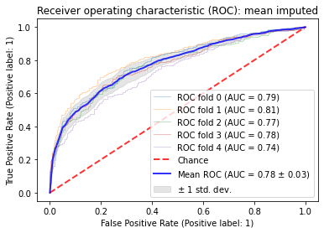
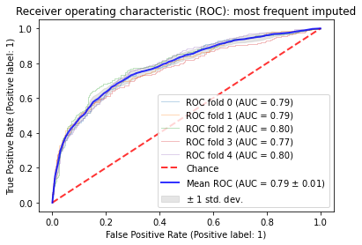
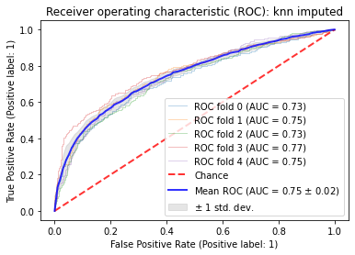
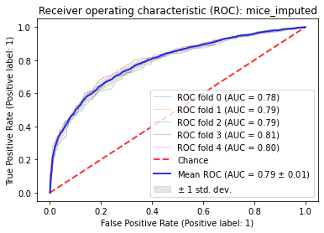

Logistic regression results
Mean Imputed
Most Frequent Imputed
KNN Imputed
MICE Imputed
MIDAS Imputed

Slide 19
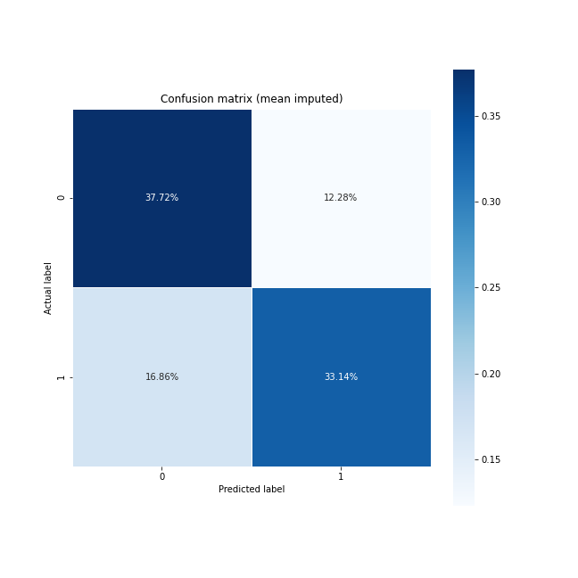
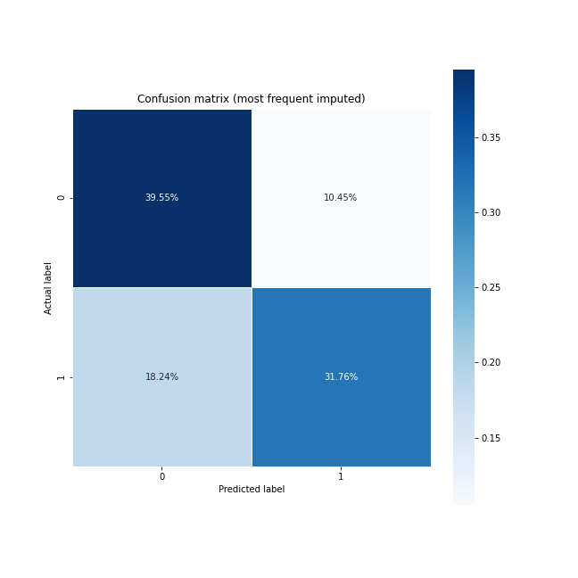



Mean Imputed
Most-Frequent Imputed
KNN Imputed
MICE Imputed
MIDAS Imputed

Slide 20
Mean Imputed
Most-Frequent Imputed
KNN Imputed
MIDAS Imputed
MICE Imputed

Slide 21
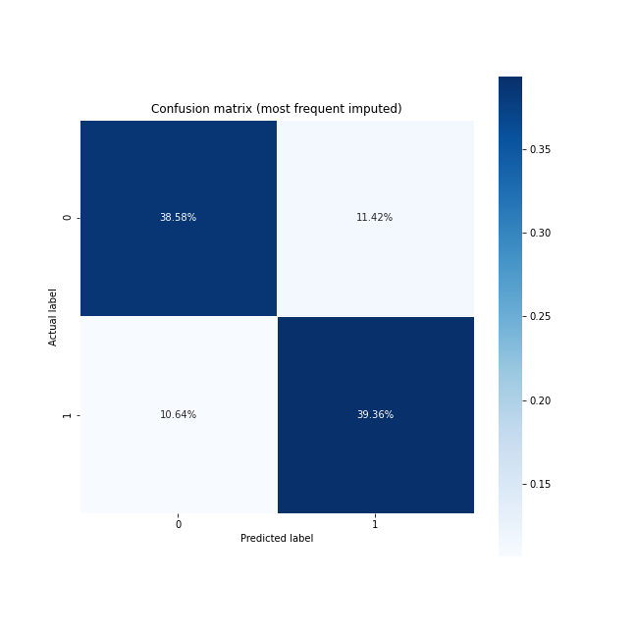
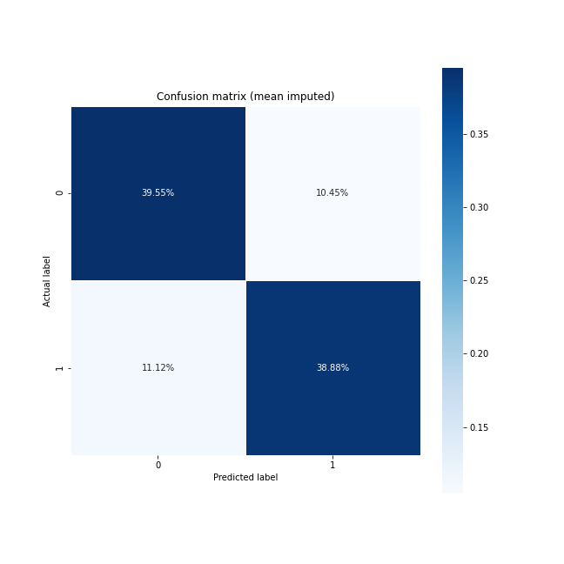


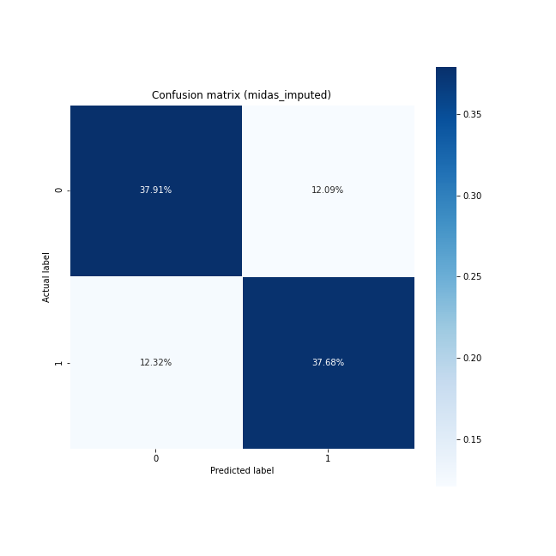
Random Forest Results

Slide 22
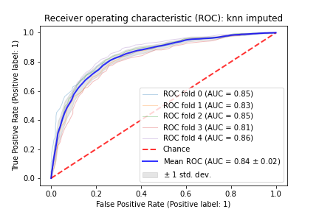
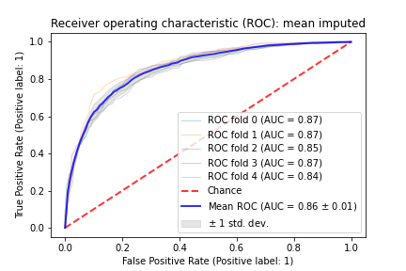

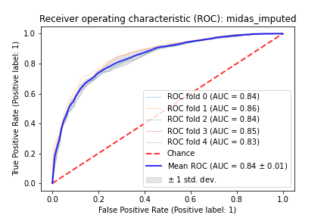
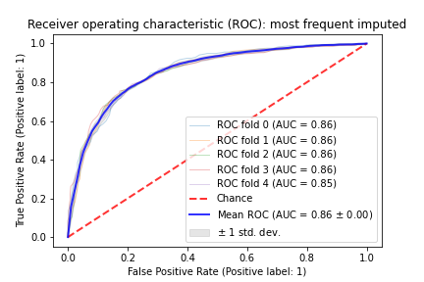

Slide 23
SVM REsults

Slide 24
Friedman test and nemenyi test (Logistic Regression)
FriedmanchisquareResult(statistic=41.17087047221472, pvalue=2.4775354613296428e-08)
['mean imputed', 'most frequent imputed', 'knn imputed', 'mice_imputed', 'midas_imputed']
 | 0 | 1 | 2 | 3 | 4
0 | 1.000000 | 0.038655 | 0.900000 | 0.900000 | 0.185688
1 | 0.038655 | 1.000000 | 0.022042 | 0.015954 | 0.001000
2 | 0.900000 | 0.022042 | 1.000000 | 0.900000 | 0.268593
3 | 0.900000 | 0.015954 | 0.900000 | 1.000000 | 0.321808
4 | 0.185688 | 0.001000 | 0.268593 | 0.321808 | 1.000000

Slide 25
FriedmanchisquareResult(statistic=5.845163732734184, pvalue=0.21101379046387692)
 | 0 | 1 | 2 | 3 | 4
0 | 1.000000 | 0.878403 | 0.312645 | 0.585651 | 0.487226
1 | 0.878403 | 1.000000 | 0.849127 | 0.900000 | 0.081183
2 | 0.312645 | 0.849127 | 1.000000 | 0.900000 | 0.003879
3 | 0.585651 | 0.900000 | 0.900000 | 1.000000 | 0.018779
4 | 0.487226 | 0.081183 | 0.003879 | 0.018779 | 1.000000

Slide 26
FriedmanchisquareResult(statistic=25.93753079120664, pvalue=3.257577637930483e-05)
0 | 1 | 2 | 3 | 4
0 | 1.000000 | 0.878403 | 0.312645 | 0.585651 | 0.487226
1 | 0.878403 | 1.000000 | 0.849127 | 0.900000 | 0.081183
2 | 0.312645 | 0.849127 | 1.000000 | 0.900000 | 0.003879
3 | 0.585651 | 0.900000 | 0.900000 | 1.000000 | 0.018779
4 | 0.487226 | 0.081183 | 0.003879 | 0.018779 | 1.000000

Slide 27
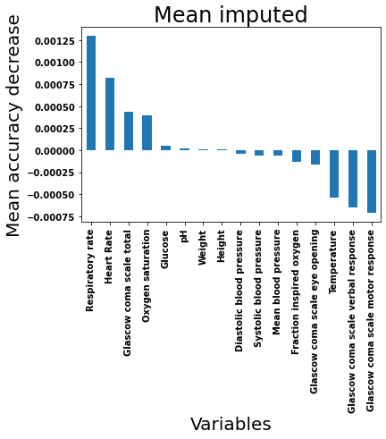
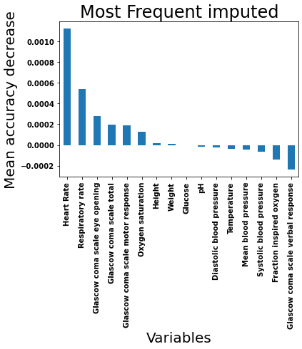
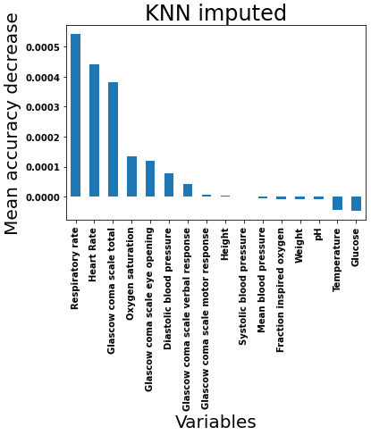
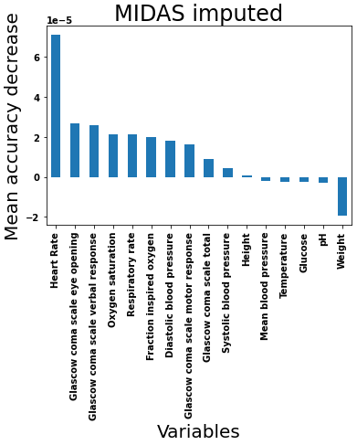
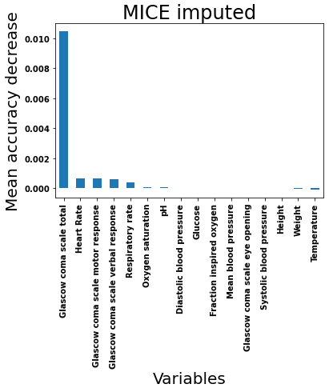
Feature importance

